Slide 1
Office 365 Development

Slide 2
Course Agenda
Introduction to Office 365 Development
Module 1: Deep Dive Apps for Office in Outlook
Module 2: Deep Dive Apps for Office in Word
Module 3: Deep Dive Apps for Office in PowerPoint
Module 4: Deep Dive Apps for Office in Excel
Module 5: Deep Dive into SharePoint Hosted Apps
Module 6: Deep Dive into Provider Hosted Apps
Module 7: Deep Dive into Security and OAuth
Module 8: App Lifecycle Management

Slide 3
Deep Dive in Office PowerPoint Add-ins

Slide 4

Agenda
Introduction to PowerPoint Add-ins
Developing PowerPoint Add-ins
Creating a Video Player
Adding a Web Service

Slide 5
Developer vision
USERS
DATA
HTML

Slide 6
What is an Office Add-in?
Web application loaded inside an Office Application
Embedded inline or as task pane within documents, mails or appointments.
Works in Office Applications such as Microsoft Outlook
Works in Office Web Applications such as OWA
Works in mobile Office clients
Office application extensions using Web technologies
HTML 5 and CSS used to construct user interface
JavaScript and jQuery used to add executable logic and event handlers
Add-in can provided code to read/write content to/from Office documents
Add-in can call Web services hosted over Internet or running within local network
Notes:
An Office Add-in can be seen as a Web page loaded inside an Office Application. In some cases it will appear embedded inline within the document. In other cases it might appear as a task pane or within a message in Outlook. Note that the architecture for Office Add-ins has been designed to work in both Office Applications and Office Web Applications.
Office Add-ins allow Office applications to be extended in such as way so that they can leverage Web technologies such as HTML 5 and CSS for rendering user interface as well as JavaScript and jQuery to add behavior. When you write the JavaScript code for an Office Add-in, you can call REST APIs such as those added to SharePoint 2013 to retrieve and update data from across network.

Slide 7



Designing Office Add-ins - Shapes
Office Add-ins come in different shapes
Task Pane Add-in
Content Add-in
Mail Add-in
Mail Compose Add-in
Word Application
Excel Application
Outlook Application
Outlook Application
Document
Task Pane App
Document
Inbox
Selected Message
Inbox
New Message
Mail Compose
App
Reply | Reply All | Forward
To: xxx@yyy.com
Subject: Top secret stuff
app
Mail App
Content App
Message Body
Message Body
Notes:
When you begin to design an app, you must pick one of the three different shapes. You can create a document-based app as either a Task Pane App or a Content App. Alternatively, you can create a Mail App that targets Outlook and Outlook OWA.

Slide 8

Anatomy of an Office Add-in
Each Office Add-in is based on XML-based manifest
Manifest points to a Web page
Manifest defines the type of the Office Add-in
Manifest defines which Office applications it supports
Manifest defines required capabilities
Office Add-in
Office Add-in
Manifest
<XML>
Web
Page
HTML+JS
Notes:
Every App for Office must be distributed with an XML-based manifest which contains information about the app itself. For example, the app manifest contains an address to a Web page on the Internet which is used to load the app. The app manifest also includes information which indicates which Office applications it supports. The app manifest also defines the required capabilities which represent the set of permissions that the app needs in order to run and complete its work.

Slide 9
Developing PowerPoint Add-ins

Slide 10
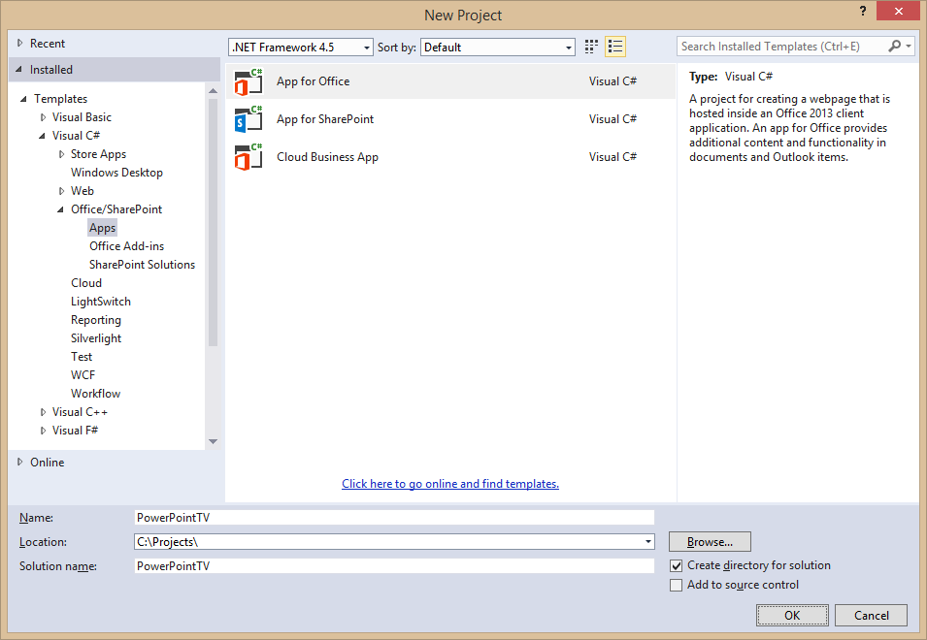
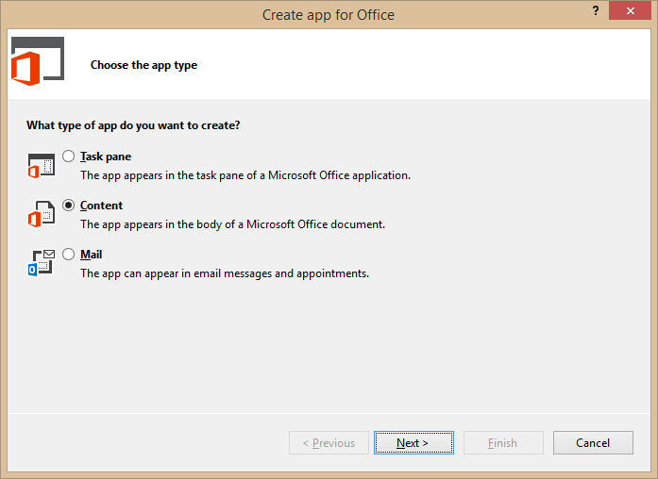
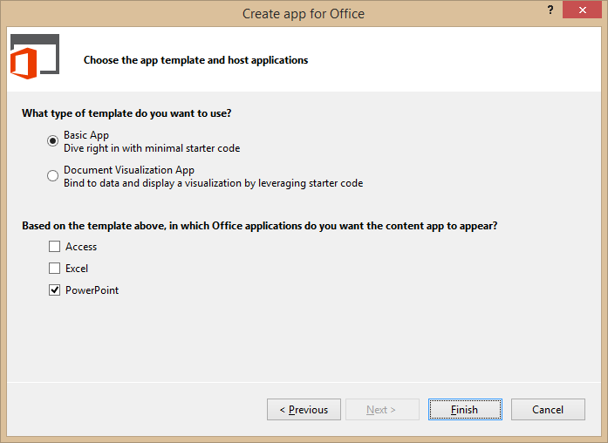
Create New Office Add-in Project
Create project based on App for Office 2013 project template
Dialogs appear and prompts you for specifics about the app
You must choose (1) the app shape and (2) which Office application are to be supported
Notes:
Visual Studio has a new project template for Apps for Office. These project types gives you a starter project with a web page and manifest.

Slide 11
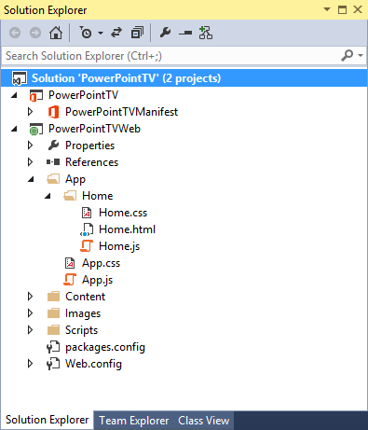
Office Add-in Project Structure
Office Add-in solution has two projects
Top project contains add-in manifest
Bottom project for remote web
Remote Web Project is ASP.NET Website
Contains HTML, CSS and JavaScript source files
Integration with jQuery library already included
Notes:
The slide shows the initial structure of a task pane add-in created with the Visual Studio.

Slide 12
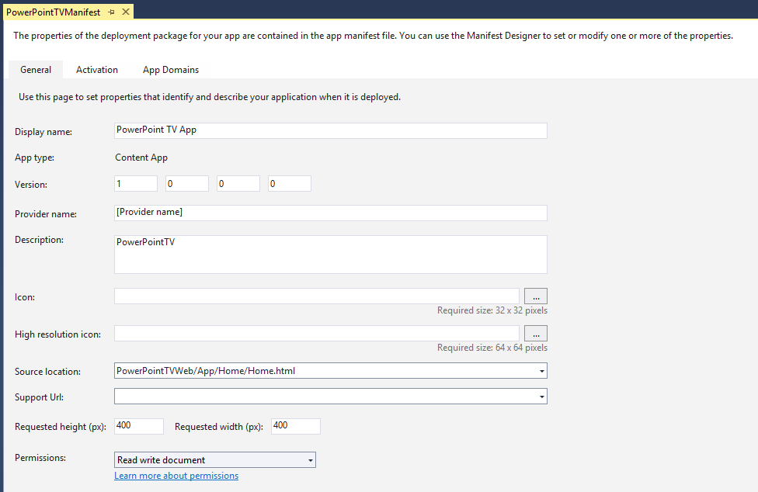
Add-in Manifest Designer
Notes:
This slide shows the Visual Studio designer for an add-in manifest in a task pane app. It will look different for other types of Office Add-in.

Slide 13
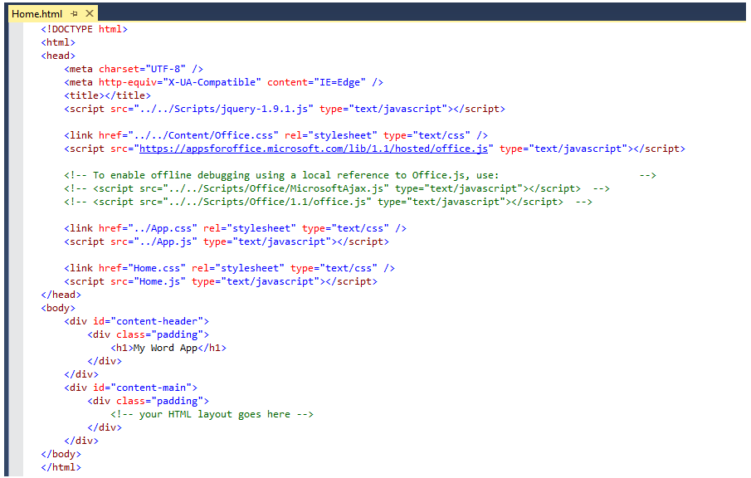
Create the HTML for a Web Page
Notes:
Each app has a source location which points to a entry point Web page somewhere on the Internet. Here is an example of a simple Web page that is used to load a task pane add-in. Note that this page must link to any required CSS files and JavaScript that will be adding styles or behavior behind the add-in. Visual Studio automatically adds the links for jQuery and ASP.NET AJAX. Also note that the page adds HTML elements which are often created with ids and/or classes.

Slide 14
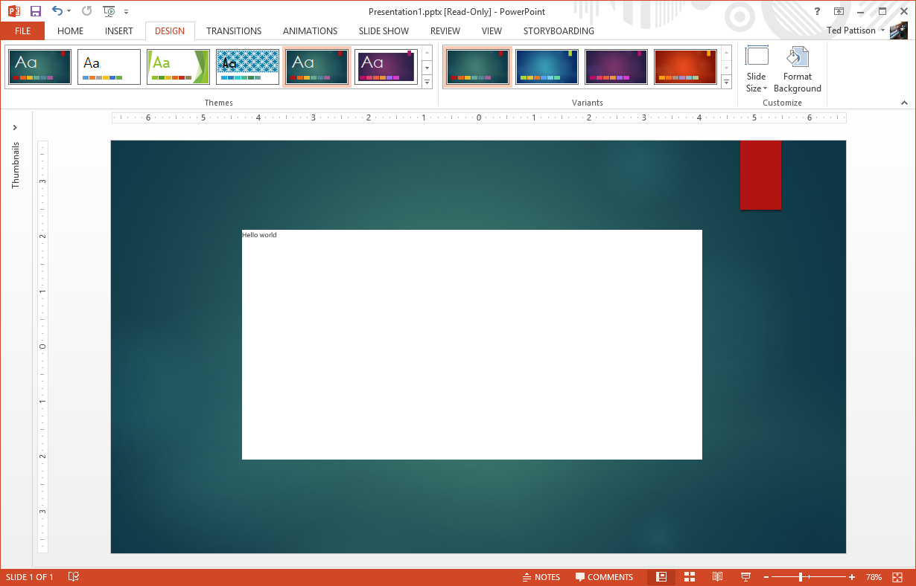
Run Project in Visual Studio Debugger

Slide 15
demo
Creating an Content PowerPoint Add-in

Slide 16
Creating a Video Player

Slide 17
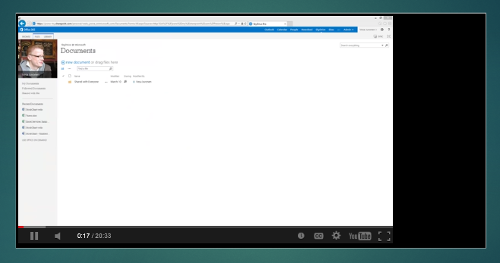
Testing the Player in the Debugger

Slide 18
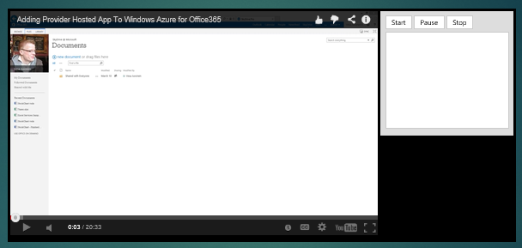
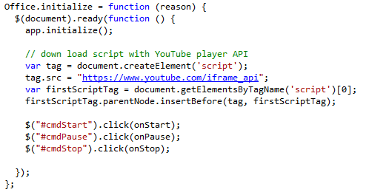
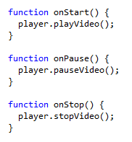
Adding in a Video Control Panel

Slide 19
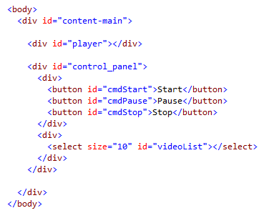
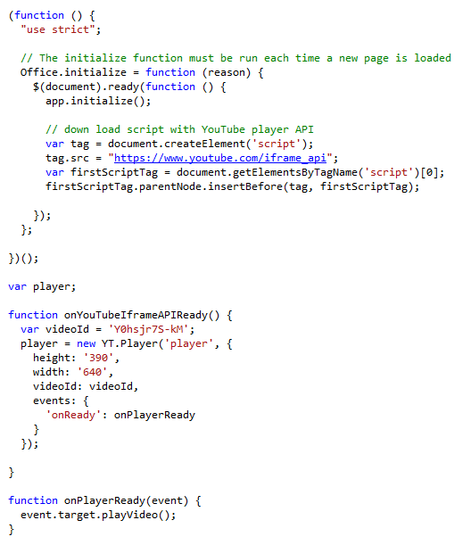
Using the YouTube Player API

Slide 20
demo
Creating a YouTube Video Player

Slide 21
Adding a Web Service

Slide 22
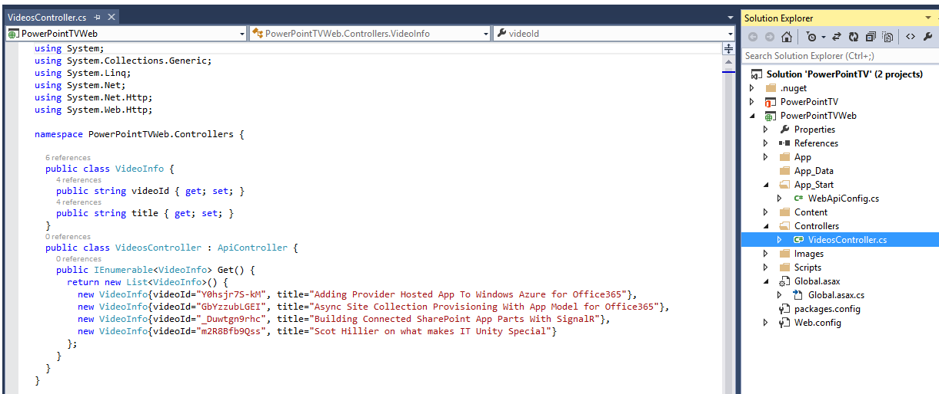
Adding Web Service Support

Slide 23
demo
Adding a Web Service to an Office Add-in

Slide 24
Related Documentation
MSDN: Create a task pane add-in with Napa Office 365 Development Tools
https://msdn.microsoft.com/EN-US/library/office/jj554660.aspx
MSDN: Create content & task pane add-ins for PowerPoint
https://msdn.microsoft.com/EN-US/library/office/dn610884.aspx

Slide 25
Summary
Introduction to Apps for PowerPoint
Developing Apps for PowerPoint
Creating a Video Player
Adding a Web Service

Slide 26
Developer Program Launch
1 YEAR FREE
E-mail Newsletters
Free Developer Subscription
Free Training
Free Tools
Webinars
http://dev.office.com/devprogram

Slide 27


Engage
Office 365 Network
https://www.yammer.com/itpronetwork
Twitter
S
S
t
t
a
a
r
r
t
t
@OfficeDev
Stack overflow
[ms-office]
Channel 9 Dev Show
http://aka.ms/O365DevShow
Podcasts http://dev.office.com/podcasts
Snack Demos
http://aka.ms/o365DevSnackDemos
UserVoice
http://officespdev.uservoice.com/

